Slide 1
Private Aviation Analysis
October 6th 2023

Slide 2

Hello! I’m...
Gina Guerin
Project Manager
Contact:
Gina.b.Guerin@gmail.com

Slide 3
Business
Challenge
Data
Overview
Analysis
Recommendations
Future
Discoveries
Agenda
Agenda
Counsel
Future
Challenge
Data
Analysis

Slide 4
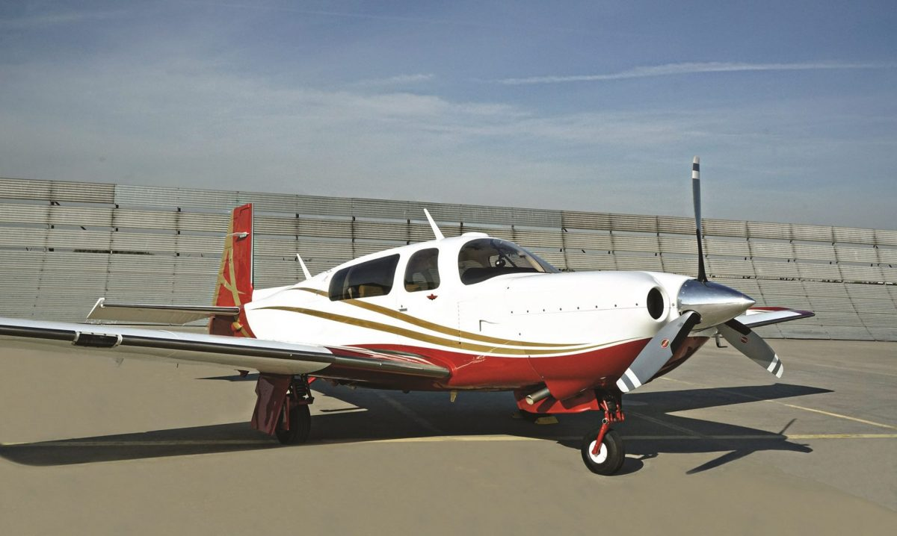
This aircraft decreases serious – fatal injuries by 88%
Agenda
Counsel
Future
Challenge
Data
Analysis

Slide 5

Business Challenge:
Where is the base airport?
What make of airplanes?
And which models?
Agenda
Counsel
Future
Challenge
Data
Analysis

Slide 6
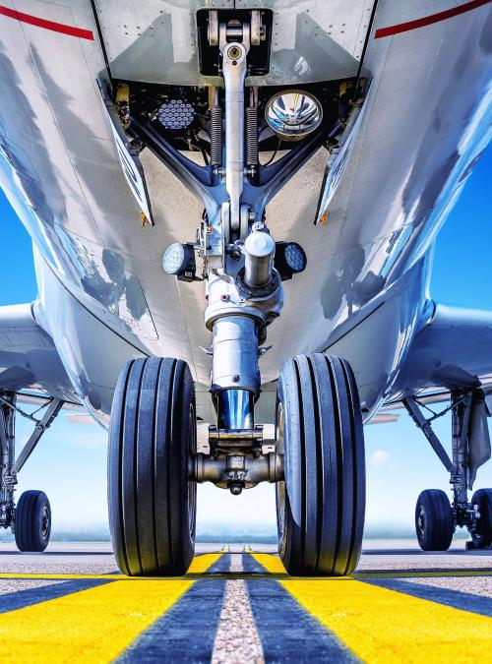
Data Overview
Source: National Transportation Safety Board
Covers accidents & incidents from 1962 – 2023
Locations & Injuries severity
We will cover last 10 years
Outside Research:
General Aviation News
Robb Report
Agenda
Counsel
Future
Challenge
Data
Analysis

Slide 7
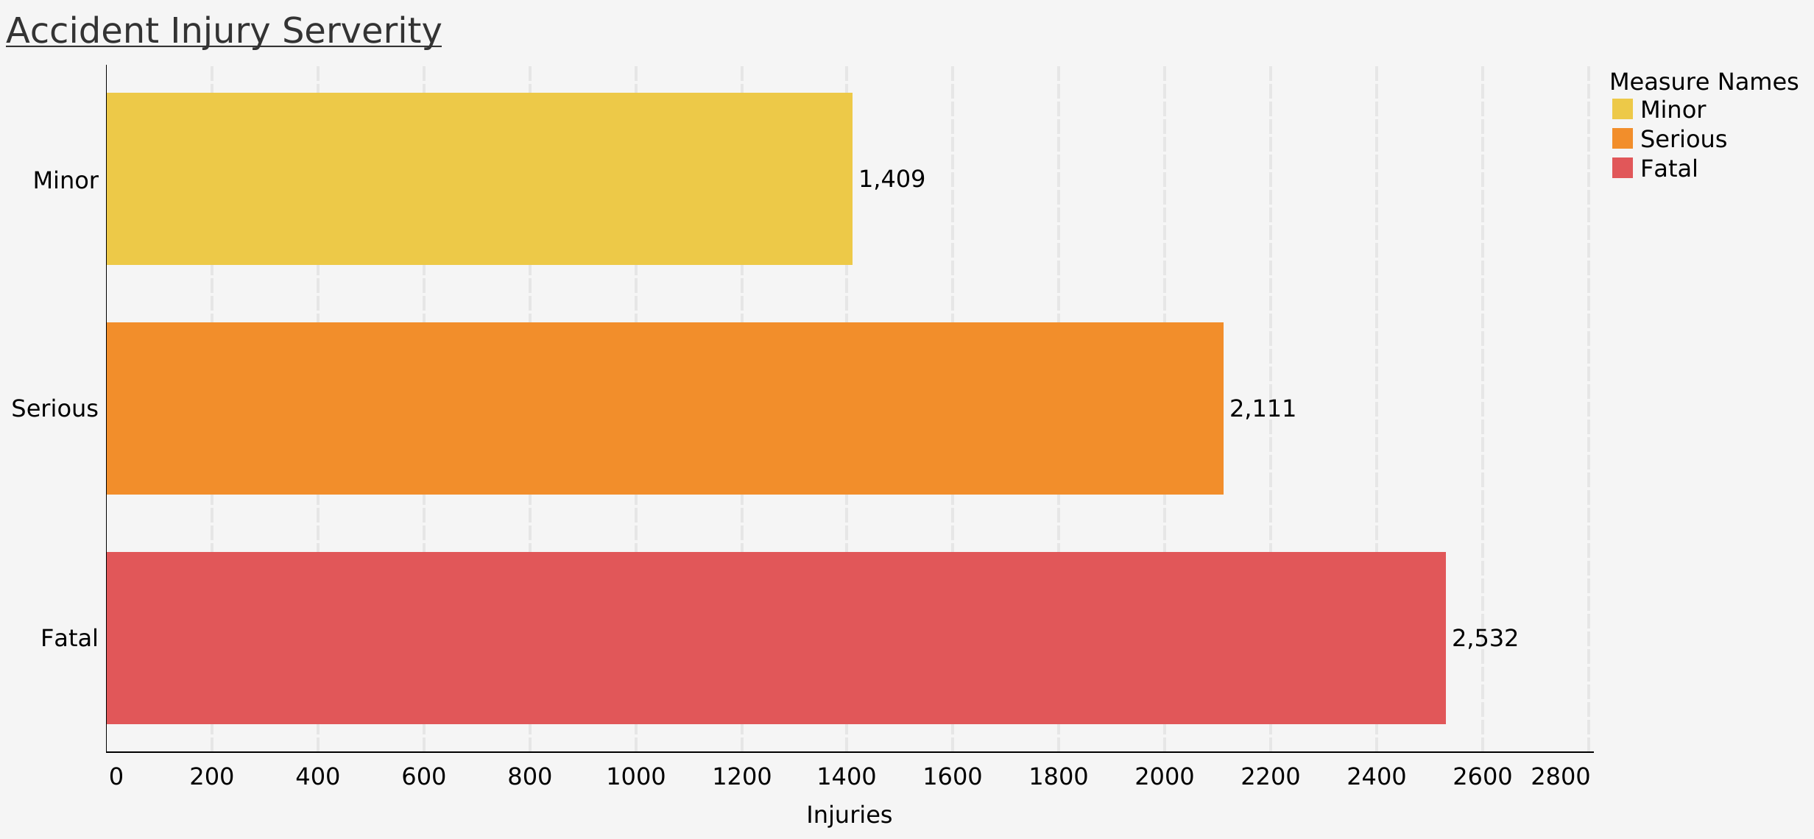
Accident Injury Severity: 2012 - 2023
Accident Injury Severity: 2012 - 2022
Agenda
Counsel
Future
Challenge
Data
Analysis

Slide 8
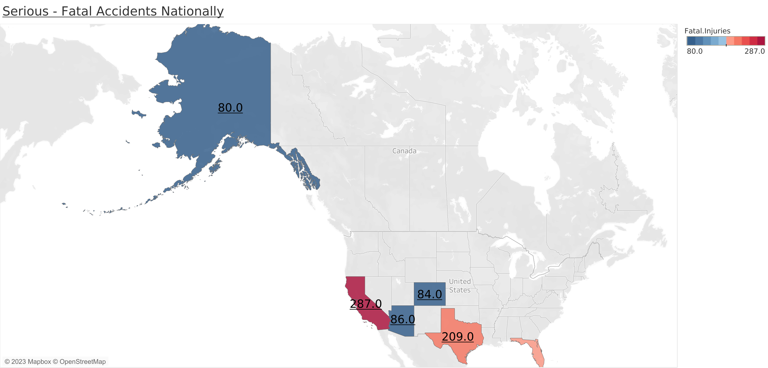
Base Airport Location
CA, TX, FL -
Highest associated to fatal injuries.
AK, TX, CA -
Most private runways
80.0
200.0
Agenda
Counsel
Future
Challenge
Data
Analysis

Slide 9
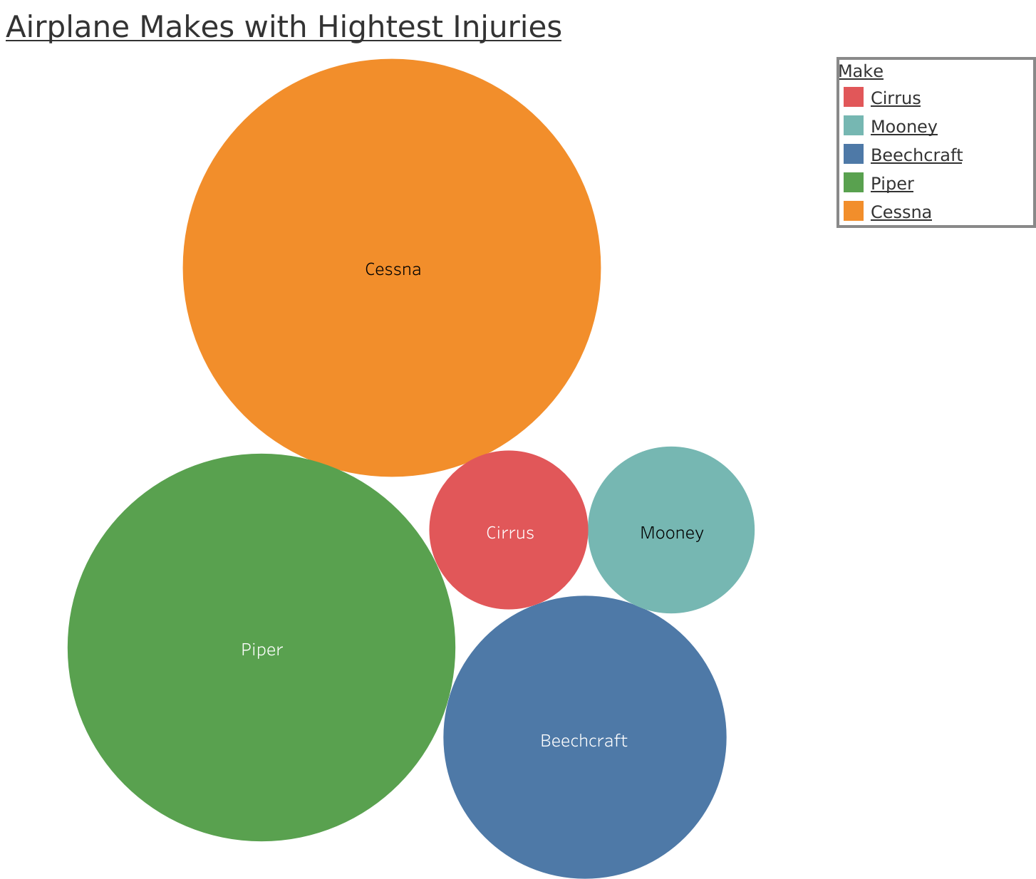
Aircraft makes
responsible
for the most
fatal accidents
Cessna
2200
Cirrus
Mooney
200
300
Piper
1600
Beechcraft
600
Agenda
Counsel
Future
Challenge
Data
Analysis

Slide 10


Recommendations
Agenda
Counsel
Future
Challenge
Data
Analysis

Slide 11

Alaska
Lower accident rates
5,882 active aircrafts
Common way of travel
Agenda
Counsel
Future
Challenge
Data
Analysis

Slide 12
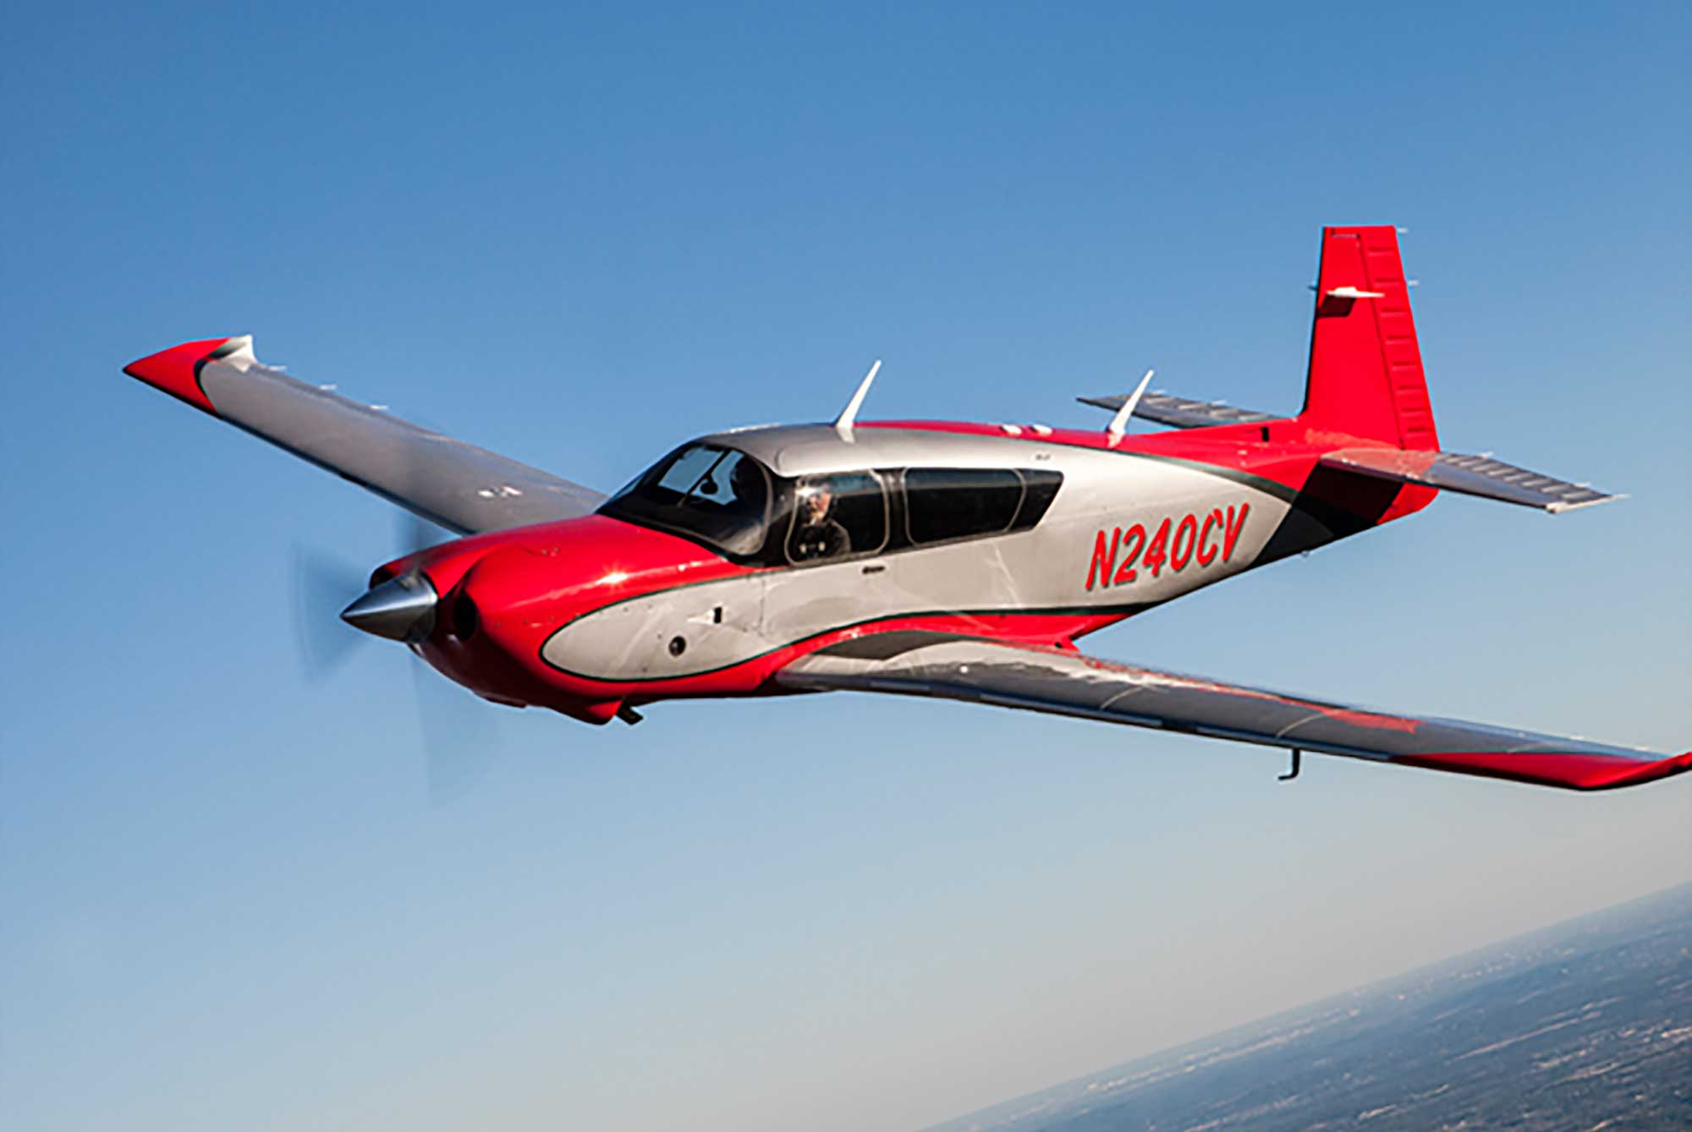
Mooney M20
Safe
Cult Airplane
Cost Effective
Agenda
Counsel
Future
Challenge
Data
Analysis

Slide 13
Future Discoveries
Expansion
International, Commercial
Aircraft Varieties
Helicopters, Airbuses
Agenda
Counsel
Future
Challenge
Data
Analysis

Slide 14
Thank you.
Gina Guerin
Project Manager
Contact
Gina.b.guerin@gmail.com
Special thanks:
Namsoo
Wes
Questions?

Slide 15
Appendix

Slide 16
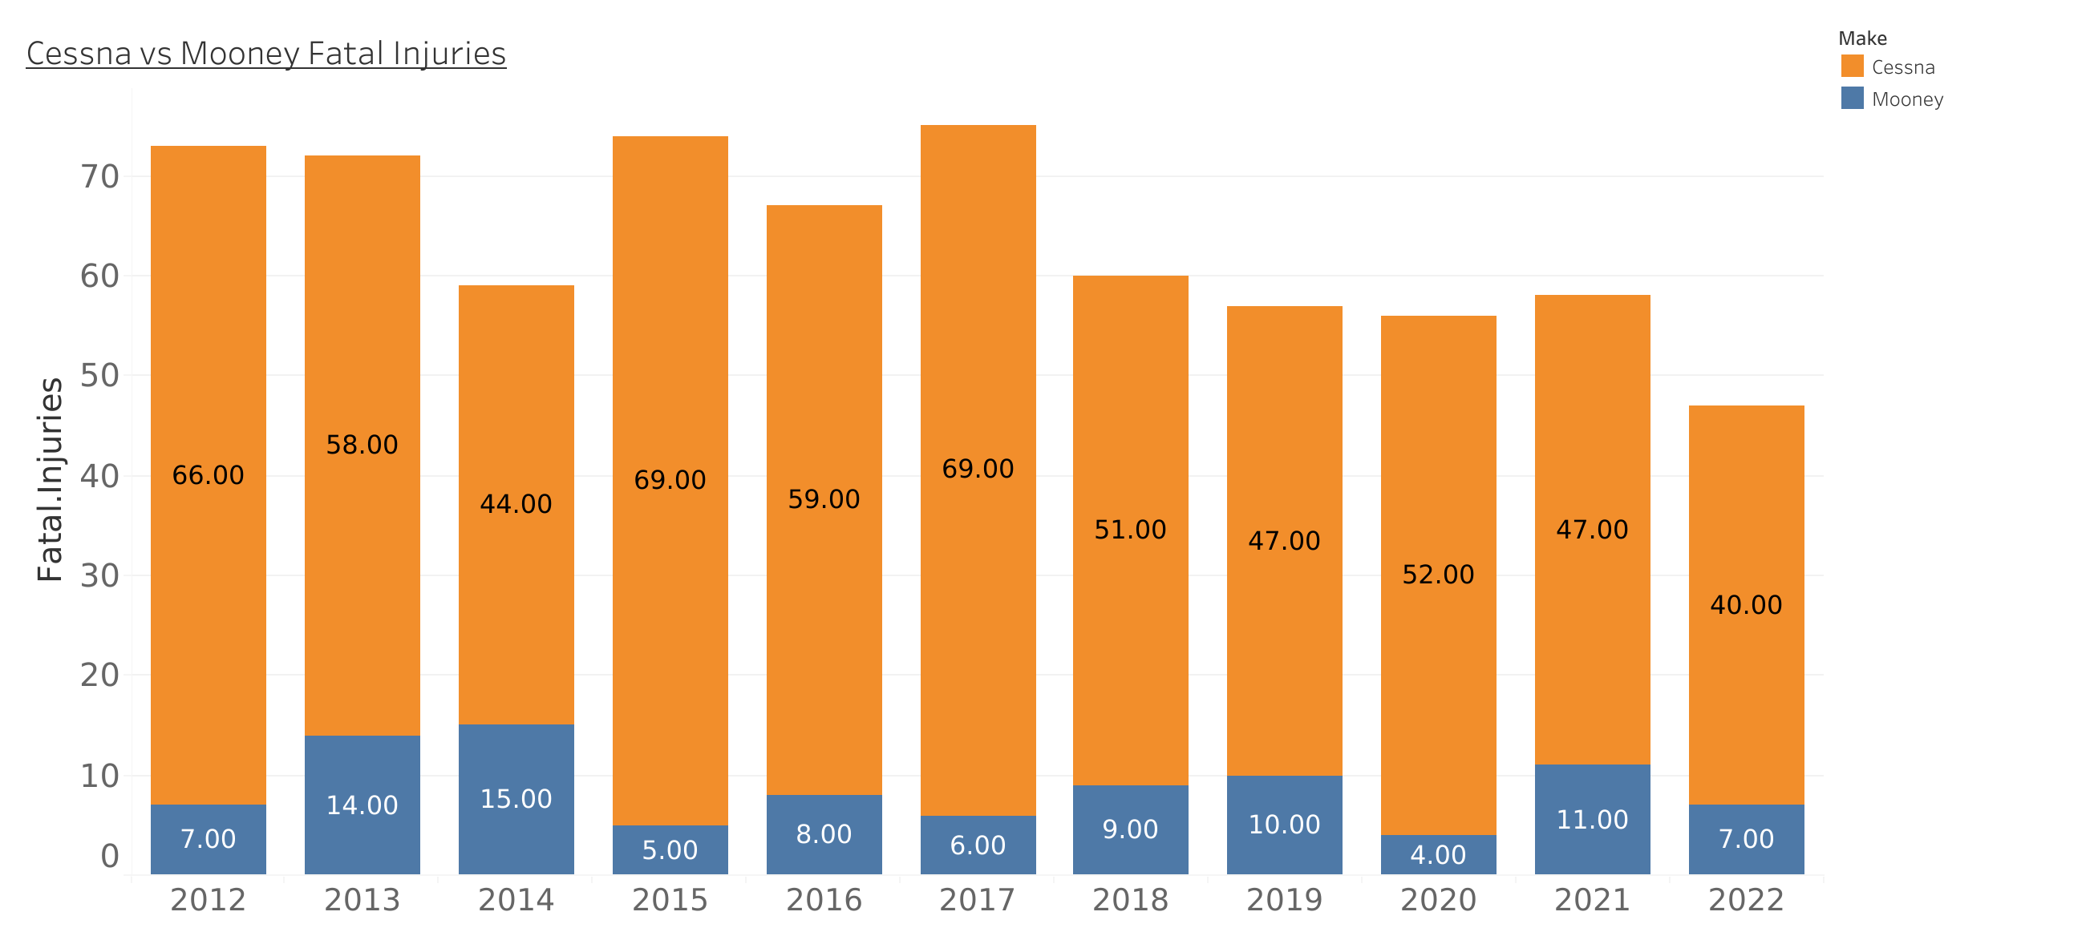
Fatal Injuries Cessna vs Mooney

